Slide 1


SQL, Python, and Shell Scripting
By Muhamad Irfan Fadhullah

Slide 2




Database?
The database is a structured system for storing data with several rules that are made in accordance with the wishes and needs of the owner based on existing problems.
There are two type of database. First, flat file database stores data in a single table structure. Second, relational database uses multiple table structures, cross-referencing records between tables. Tables in both organize records in rows, with each column containing a single piece of data in the record.
DBMS (Database management System) -> Oracle, MySQL, SQL Server, MongoDB

Slide 3






The reasons that we need the database:
2. Accuracy, Data input errors that cannot be addressed if not using a database
1. Size, how much data we have, estimates of customers who write data every day
3. Security, security of customer data and data traffic that occur (privacy)
4. Redundancy, the similarity of data that occurs, so that conflicts can occur
5. Importance, if an error occurs and crashes resulting in our important data being lost.
6. Overwriting, if there are 100 customers who write or input data simultaneously, resulting in overlapping data with one another.

Slide 4
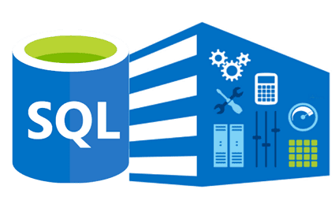
SQL?
Structured Query Language (SQL)
Structured Query Language (SQL) is a programming language that is typically used in relational database or data stream management systems.
It was developed by IBM in the early 1970s and is now an official standard recognized by the American National Standards Institute (ANSI) and the International Organization for Standardization (ISO).

Slide 5
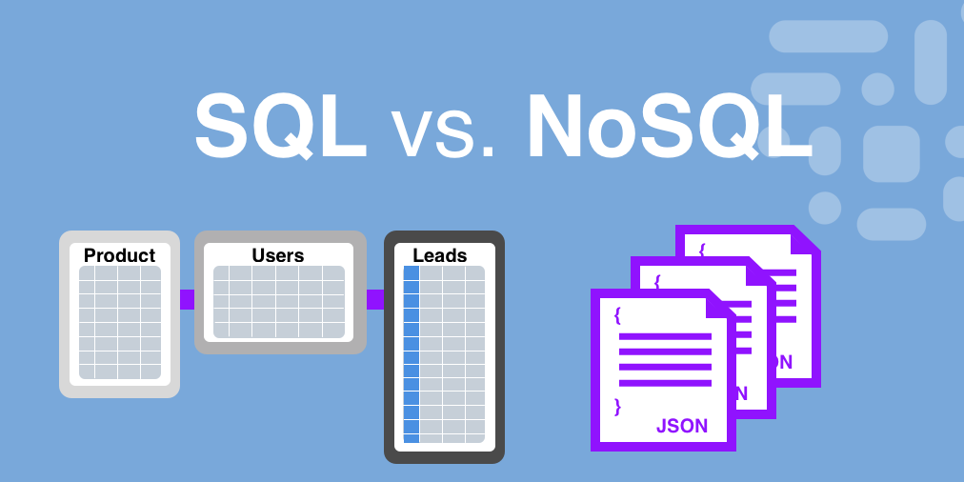

Slide 6
Basic Command SQL
Data Definition Language (DDL)
This includes CREATE (tables, views, objects, etc.), ALTER and DROP (delete).
Data Manipulation Language (DML)
SELECT, INSERT, UPDATE, DELETE of records within tables.
Data Control Language (DCL)
GRANT and/or REVOKE user privileges, etc.
Struecture SQL
SELECT [ DISTINCT ] column_name1, column_name2 FROM
table_name WHERE [condition, comparison_operator,
logical_operator ] [ LIMIT ] n_row [ ORDER BY ] column_name
[ASC/ DESC ]

Slide 7
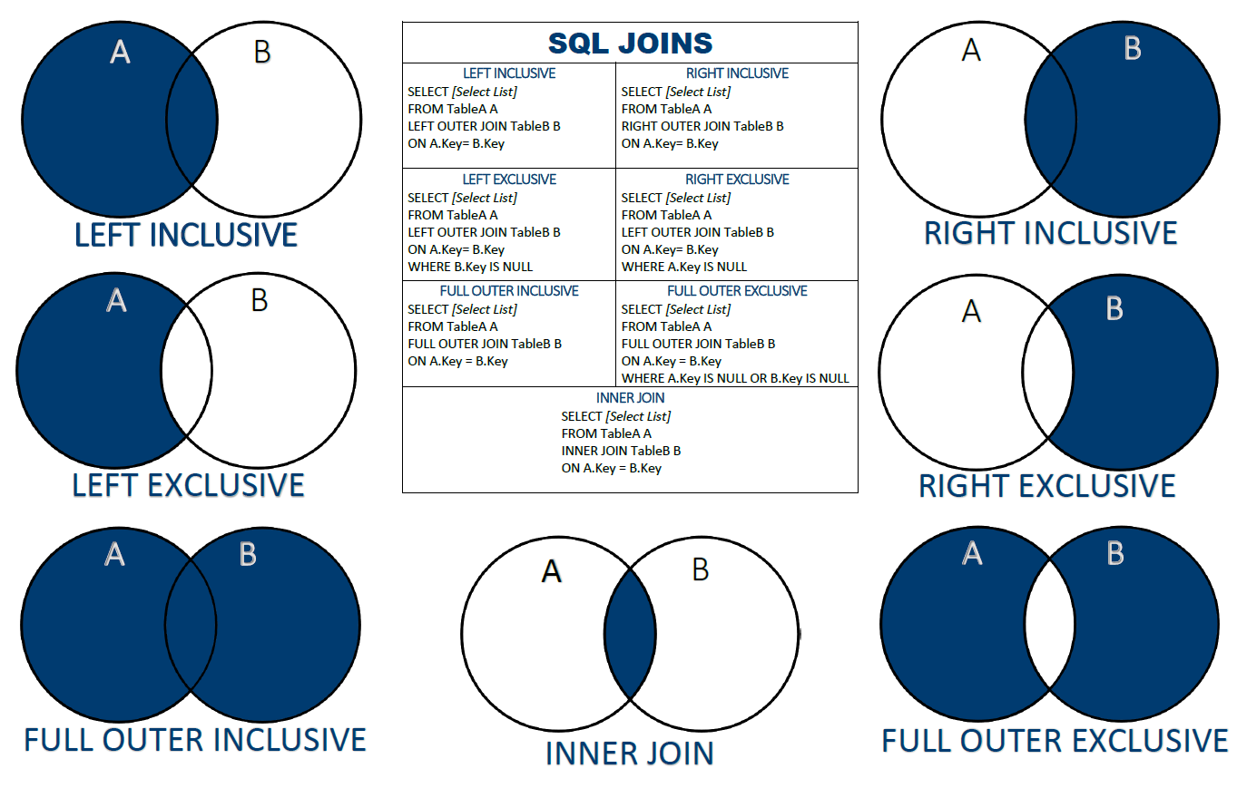
Join

Slide 8


Python Fundamental
Python is a popular programming language. It was created by Guido van Rossum, and released in 1991.
It is used for:
web development (server-side),
software development,
mathematics,
system scripting.
Data Scientist and Machine Learning

Slide 9
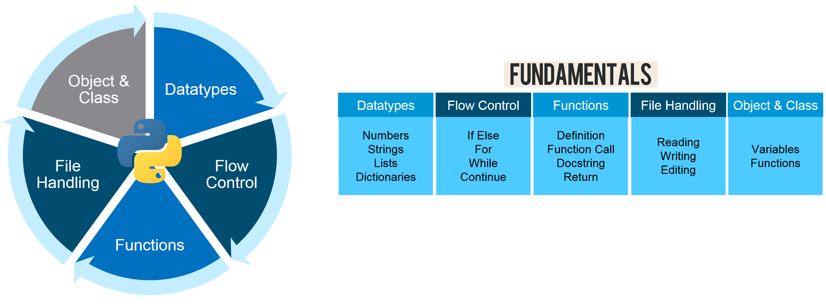
Basic Python

Slide 10
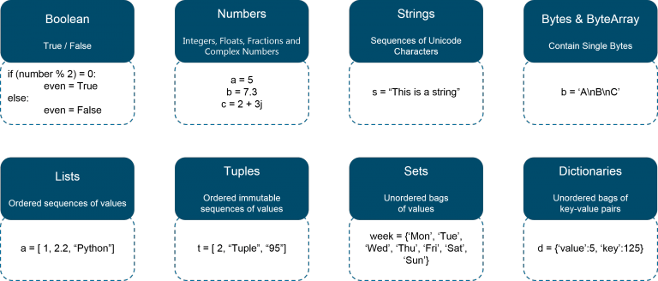

Slide 11
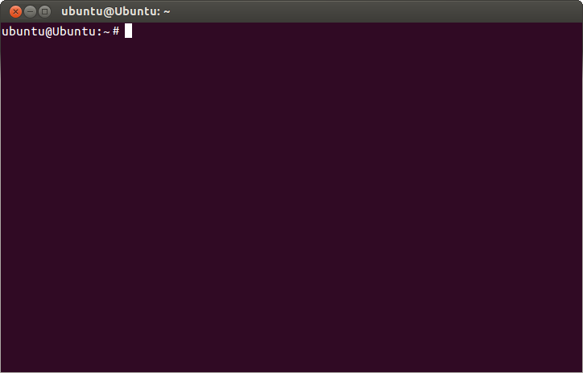



Shell Scripting Linux
Shell Script is a programming language that is compiled based on shell commands. If you use linux, then compiling shell commands in a shell file is the same as when you create an application.
In the data science, shell scripting is useful when store or deploy the model to the application or server.
Shell scripting terminal can be found in the linux, windows, and macOS

Slide 12

Basic command in Shell Scripting:
mkdir → to create some folder or directory
nano/vim/cat simplefile.txt → to create some file like text, python, or something.
cp → to copy and paste file
rm → to remove the file
mv → to move the file to other directory

Slide 13
Reference
https://www.shellscript.sh/
https://www.techwalla.com/articles/difference-flat-file-relational-database
https://iykra.com
https://www.techopedia.com/definition/1245/structured-query-language-sql
https://www.w3schools.com
https://Wikipedia.com

Slide 14
Thank You

